Slide 1
Corruption Indicators for Balkan Energy Sectors:
A Three Pillar Approach
Kelly Friedman

Slide 2
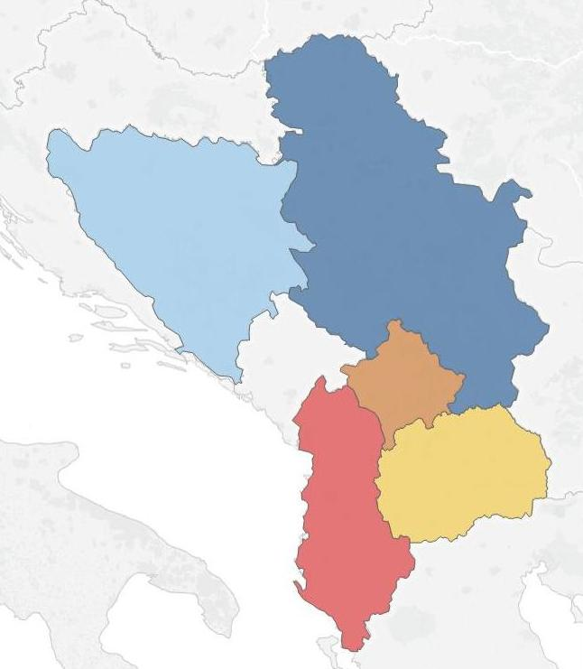
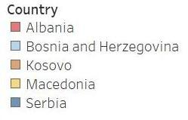
Background
Reasons for the project:
High prevalence of corruption in energy, the Balkans
Corruption leads to loss, hampers growth
Measures show where to watch
Constraints:
USAID Balkans countries
Use of existing data
Notes:
Interviews – energy and corruption specialists

Slide 3
Methodology
Research question: How can corruption in the energy sector be measured with existing data?
Literature review
Expert interviews
3 pillars
Data sources

Slide 4
How does corruption manifest in the energy sector?
State-owned enterprises have inefficiencies and are politicized
Regulatory agencies lack independence
Private firms and players have questionable relationships with political elites
Investment and procurement are non-transparent and politicized
Macedonia example: Regulator changing caps on different energy types
Notes:
Quick one sentence about meaning of energy sector
“In these countries, the energy sector is generally…

Slide 5
Key takeaways
From the literature:
  Different definitions of corruption
  Perception and experience based indicators
  Measurement issues
  Lack of energy-specific indicators
From interviews:
  Difficulty finding data
  Difficulty trusting data
  Importance of the media
  Importance of the legal system
  Use of proxy measures
  Comparison to self
Notes:
Measuring corruption is an art form
Perception- and experience-based
CPI and WGI
Issues with measuring
Can’t be measured directly
Meaning of corruption
United Nations: The abuse of power for private gain
Input-based measures more actionable
Combine quantitative with qualitative
Methods for measuring
Perception, experience, specific risks
Heinrich and Hodess: mixture of methodologies

Slide 6
The Three Pillars
NON-SECTOR PILLARS:
Pillar 1: Checks on corruption
  To understand the strength of the media, judiciary, etc.
  Existing indicators
Pillar 2: Perceptions of and experiences with corruption
  To understand perceptions and experiences with bribery, favoritism, etc.
  Existing indicators
SECTOR PILLAR:
Pillar 3: Corruption in the energy sector
  Proxy measures that show possibility for corruption to manifest and in which areas
  Indicators created from existing data
Notes:
As a result of the literature and interviews, I determined that currently the best way to consider energy sector corruption was through a 3 pillar approach that explores both the country as a whole and aspects particular to the energy sector.

Slide 7
Criteria
Round 1 – inclusion criteria
- Available for 4+ countries
- Non-redundant
Round 2 – analytic criteria
- Valid & reliable
- Meaningful & understandable
- Easily understood
- Substantial impact
- Transparent
- Available

Slide 8
Data Sources
Business Environment and Enterprise Survey (BEEPS)
Bertelsmann Transformation Index (BTI)
Freedom House Nations in Transit (FHNT)
The World Economic Forum Global Competitiveness Report (GCR)
Heritage Foundation Index of Economic Freedom (HFIEF)
International Research and Exchanges Board Media Sustainability Index (MSI)
Energy Community Secretariat Annual Implementation Report (ECS)

Slide 9
Pillar 1 Recommendations – Checks on Corruption
 | Valid and reliable | Meaningful and understandable | Actionable | Transparent | Available
BTI: Freedom of Expression | Strong | Medium | Weak | Strong | Strong
BTI: Independent Judiciary | Strong | Medium | Weak | Strong | Strong
GCR: Auditing and Reporting | Strong | Medium | Weak | Strong | Medium
FHNT: Independent Media | Strong | Medium | Weak | Medium | Strong
Notes:
Highlight one indicator

Slide 10
Pillar 2 Recommendations – Perceptions of and Experiences with Corruption
 | Valid and Reliable | Meaningful and Understandable | Actionable | Transparent | Available
BEEPS: Gifts for gov. contract | Medium | Medium | Weak | Strong | Strong
BTI: Anti-corruption policy | Strong | Medium | Weak | Strong | Strong
BTI: Prosecution of abuse | Strong | Medium | Weak | Strong | Strong
GCR: Favoritism of gov. officials | Strong | Medium | Weak | Strong | Medium
Notes:
Highlight one indicator

Slide 11
Pillar 3 Recommendations – Corruption in the Energy Sector
 | Valid and Reliable | Meaningful and Understandable | Actionable | Transparent | Available
ECS: Regulatory Authority | Strong | Strong | Strong | Strong | Strong
ECS: Unbundling | Strong | Strong | Strong | Strong | Strong
ECS: Market and prices | Strong | Strong | Strong | Strong | Strong
ECS: Customer Eligibility | Strong | Strong | Strong | Strong | Strong
Notes:
Highlight one indicator

Slide 12

Questions?

Slide 13
Additional Pillar 1 indicators considered
 | Valid and Reliable | Meaningful and Understandable | Actionable | Transparent | Available
BTI: Market competition | Strong | Medium | Weak | Strong | Strong
FHNT: Judicial Framework and Independence | Strong | Weak | Weak | Medium | Strong
GCR: Judicial Independence | Strong | Medium | Weak | Strong | Medium
FHNT: Civil Society | Strong | Weak | Weak | Medium | Strong
Notes:
Highlight one indicator

Slide 14
Additional Pillar 2 indicators considered
 | Valid and Reliable | Meaningful and Understandable | Actionable | Transparent | Available
FHNT: Corruption | Strong | Weak | Weak | Medium | Strong
GCR: Diversion of Public Funds | Strong | Medium | Weak | Strong | Medium
GCR: Public trust in politicians | Strong | Medium | Weak | Strong | Medium
GCR: Irregular payments and bribes | Strong | Weak | Weak | Strong | Medium
Notes:
Highlight one indicator

Slide 15
Additional Pillar 3 indicators considered
 | Valid and Reliable | Meaningful and Understandable | Actionable | Transparent | Available
BEEPS: Gifts for electricity | Medium | Strong | Medium | Strong | Strong
GCR: Quality of electricity | Strong | Strong | Medium | Strong | Medium
ECS: RE – Support Schemes | Strong | Medium | Strong | Strong | Strong
ECS: Annual Statistics | Strong | Strong | Strong | Strong | Strong
Notes:
Highlight one indicator

